Slide 1
Sentiment-and-Emotion-Analyser-using-DistilBERT

Slide 2
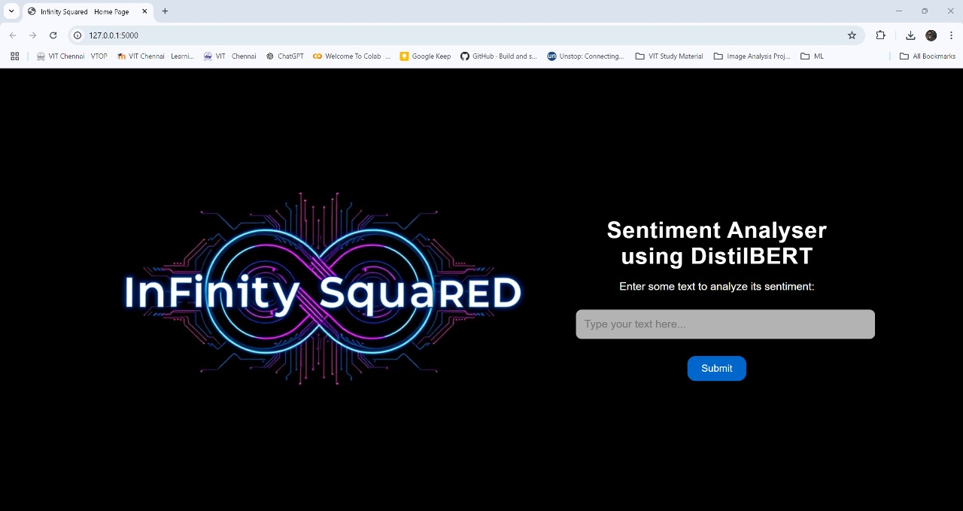
Working Model

Slide 3
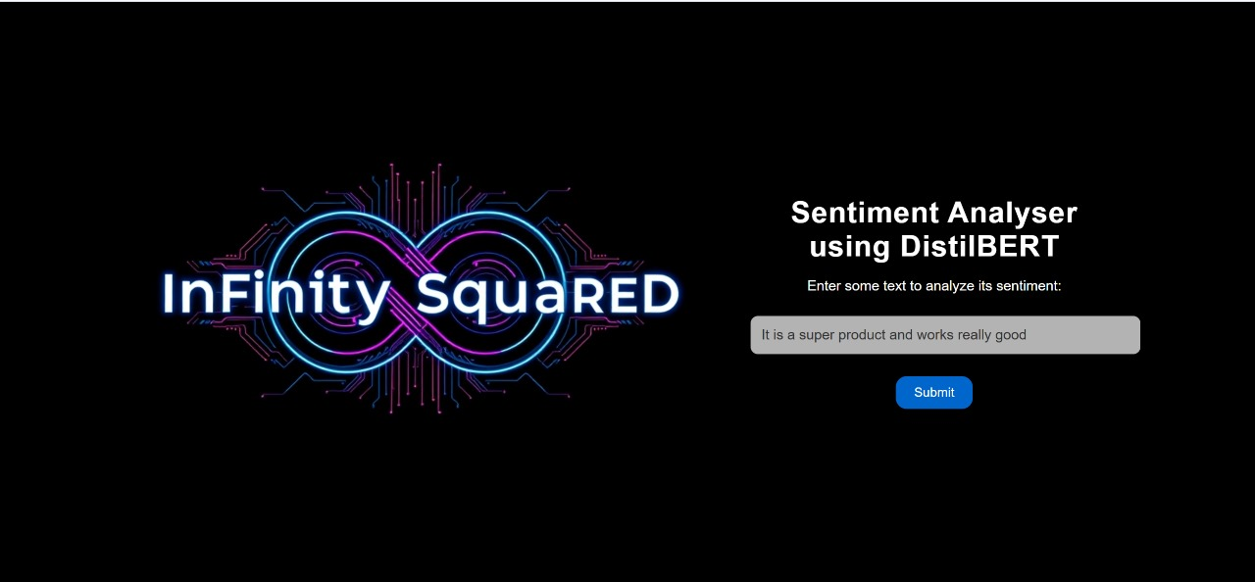

Slide 4
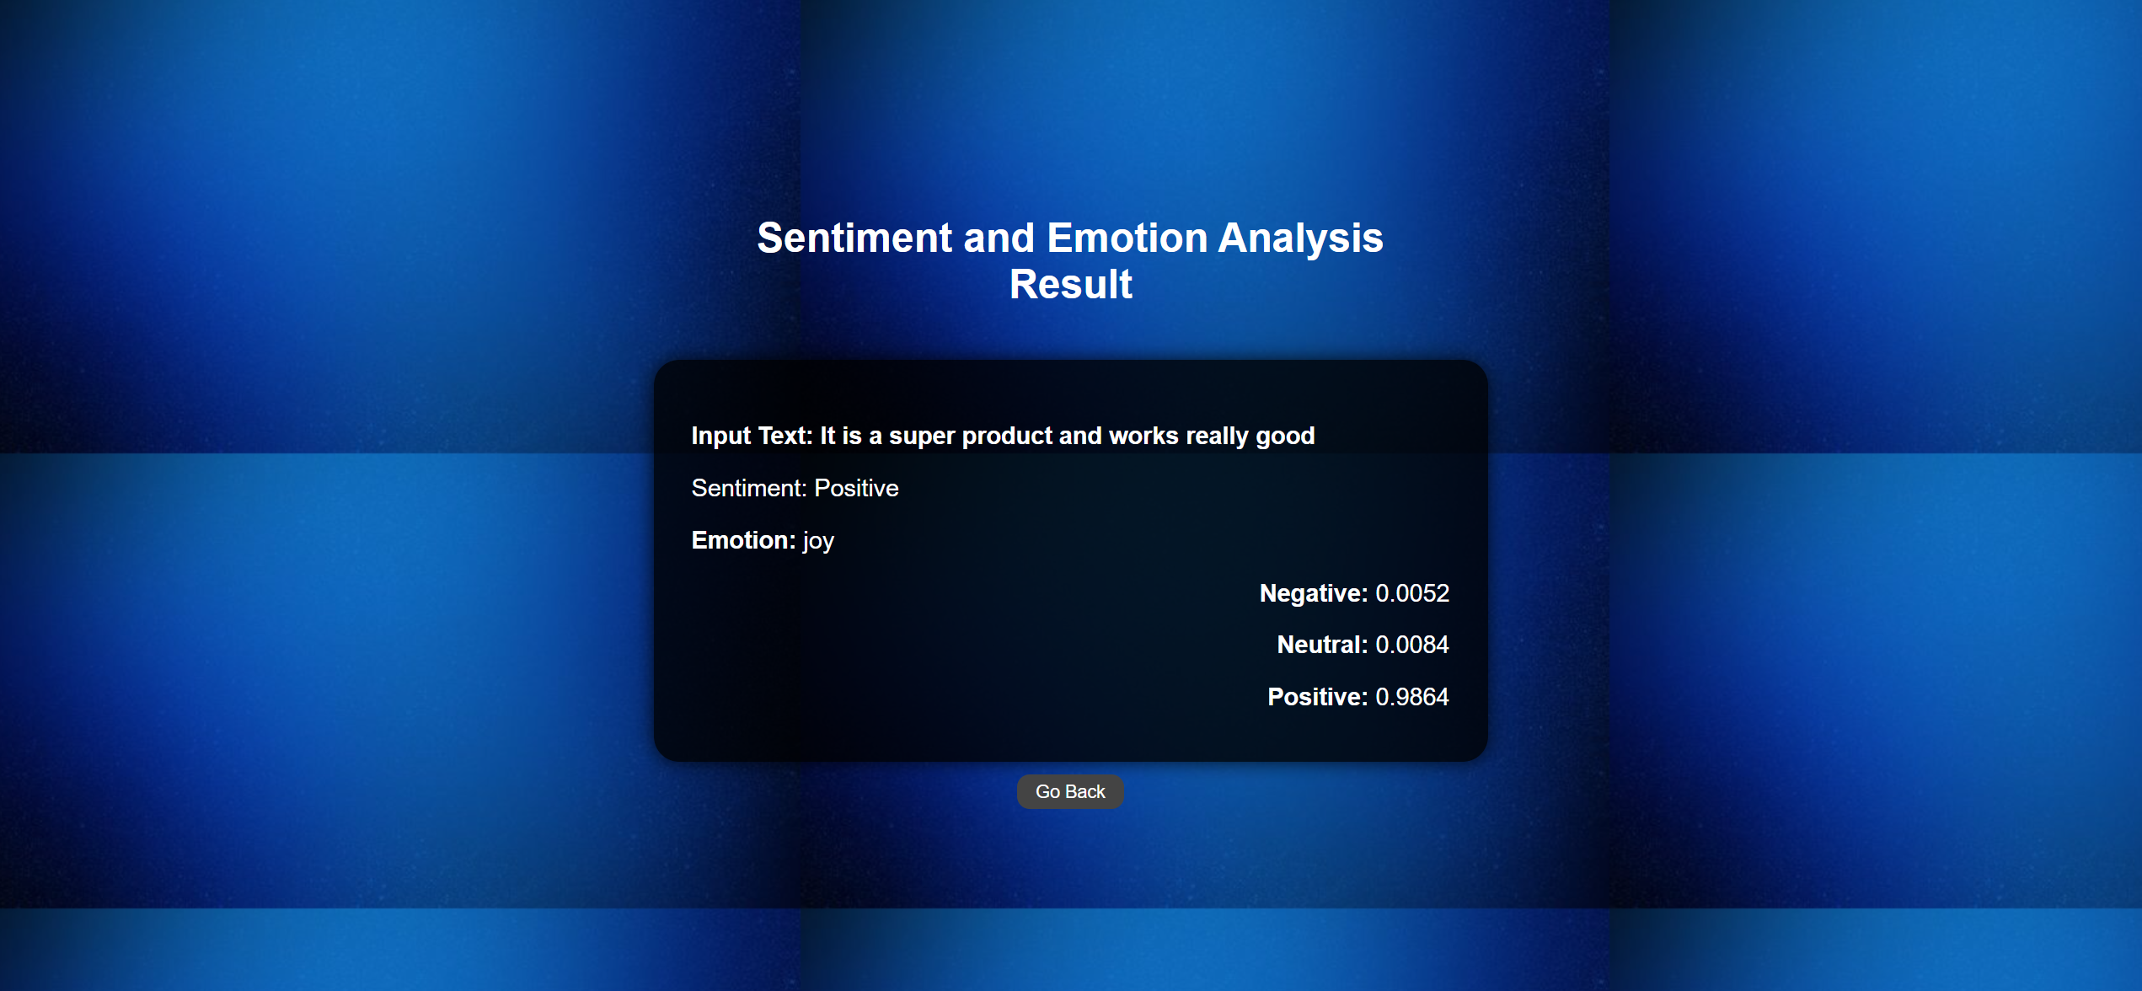

Slide 5
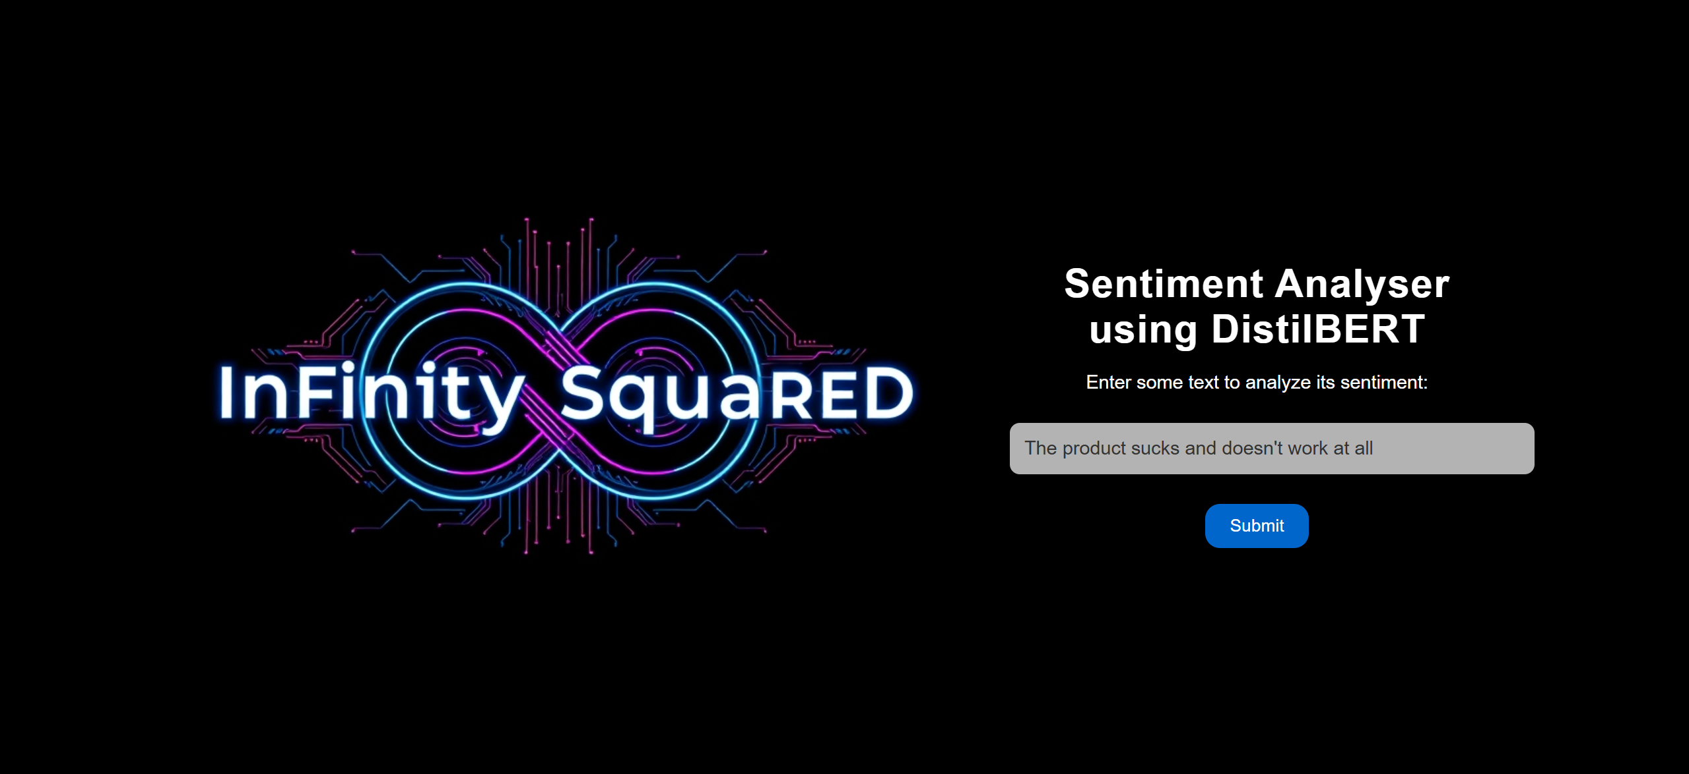

Slide 6
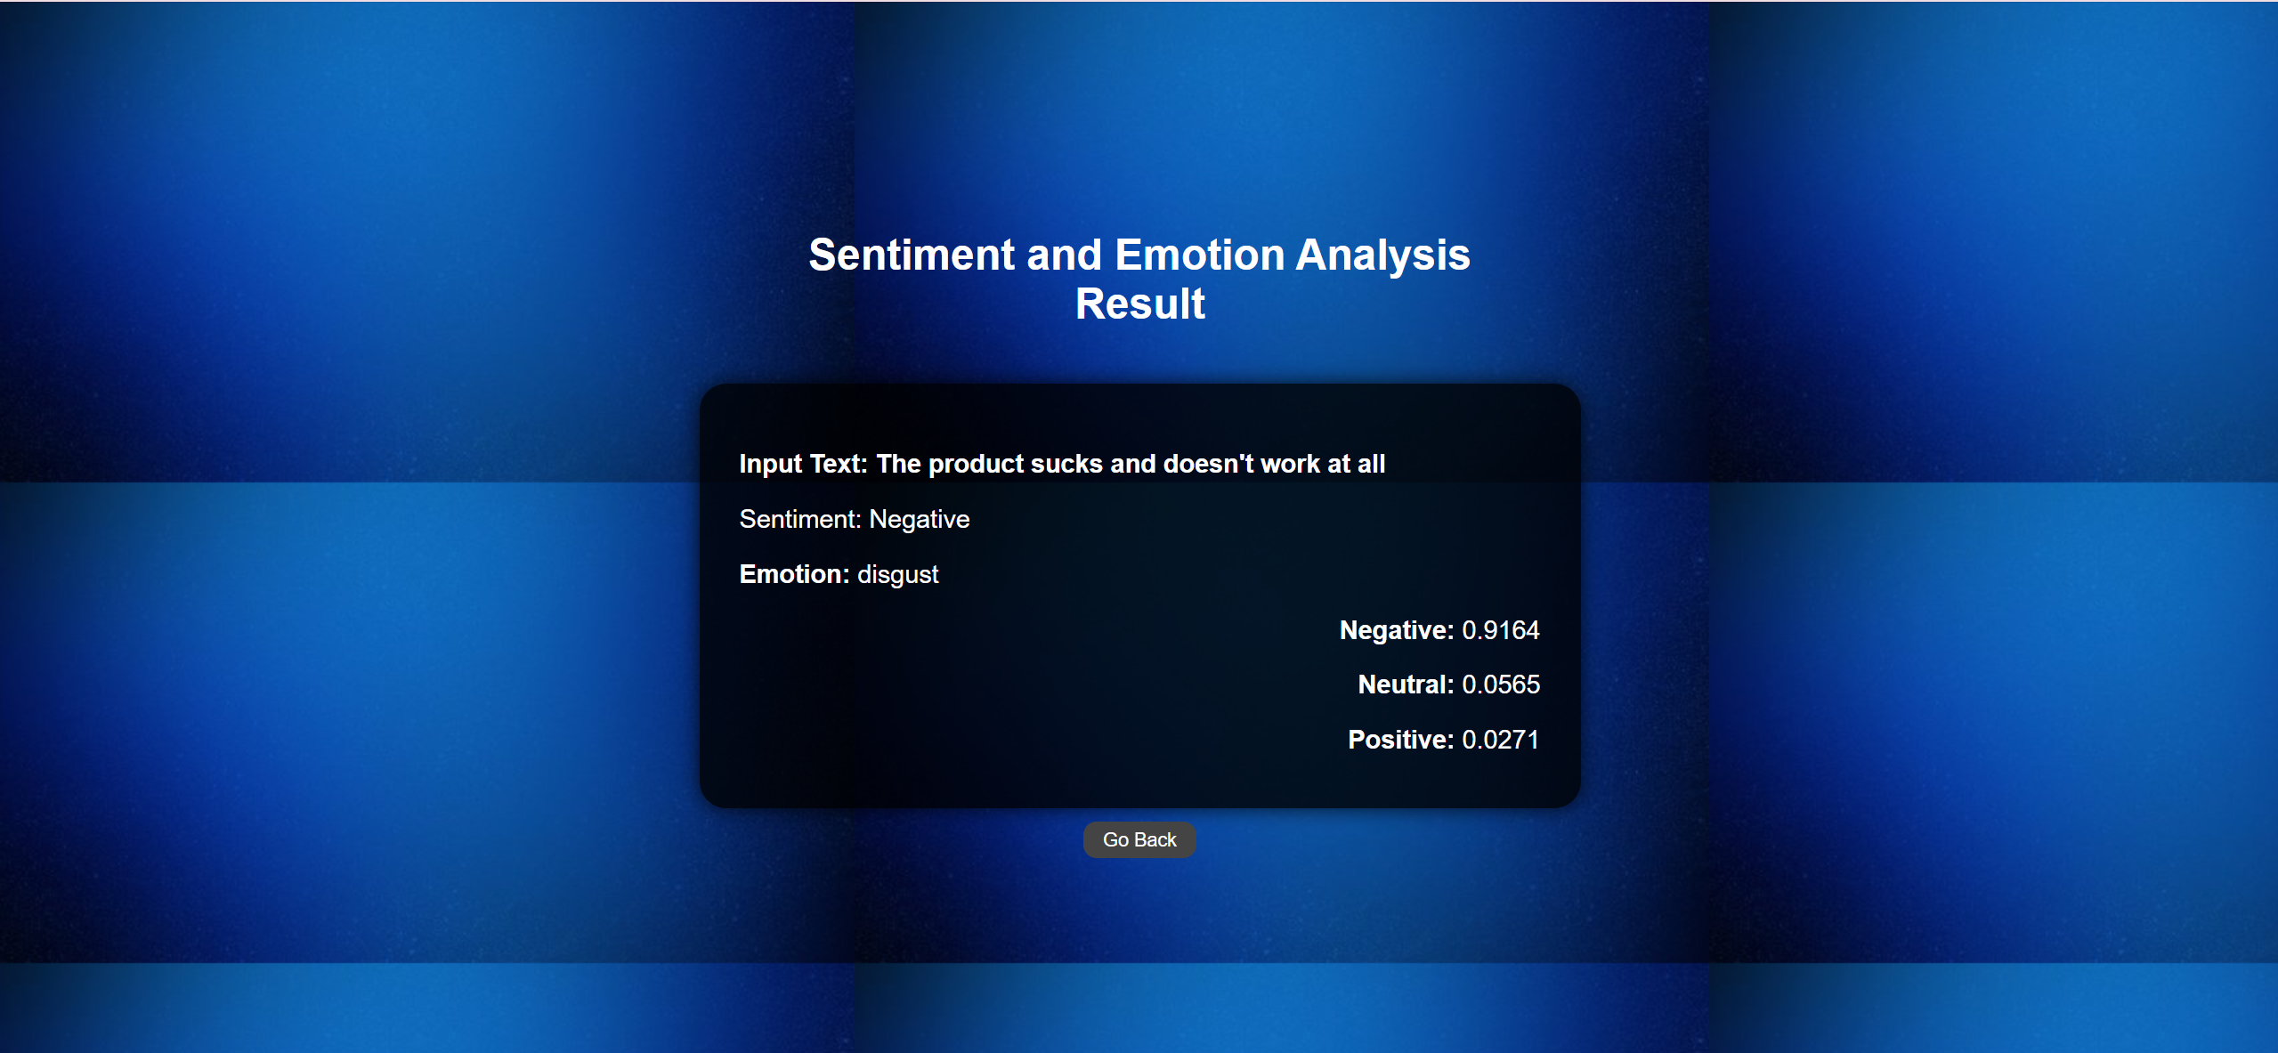

Slide 7
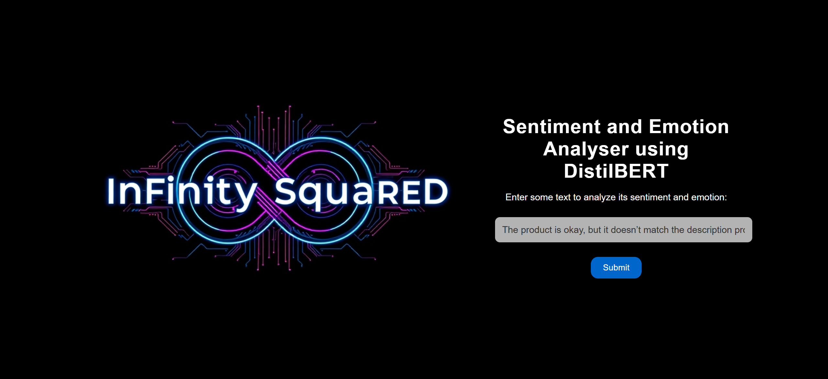

Slide 8
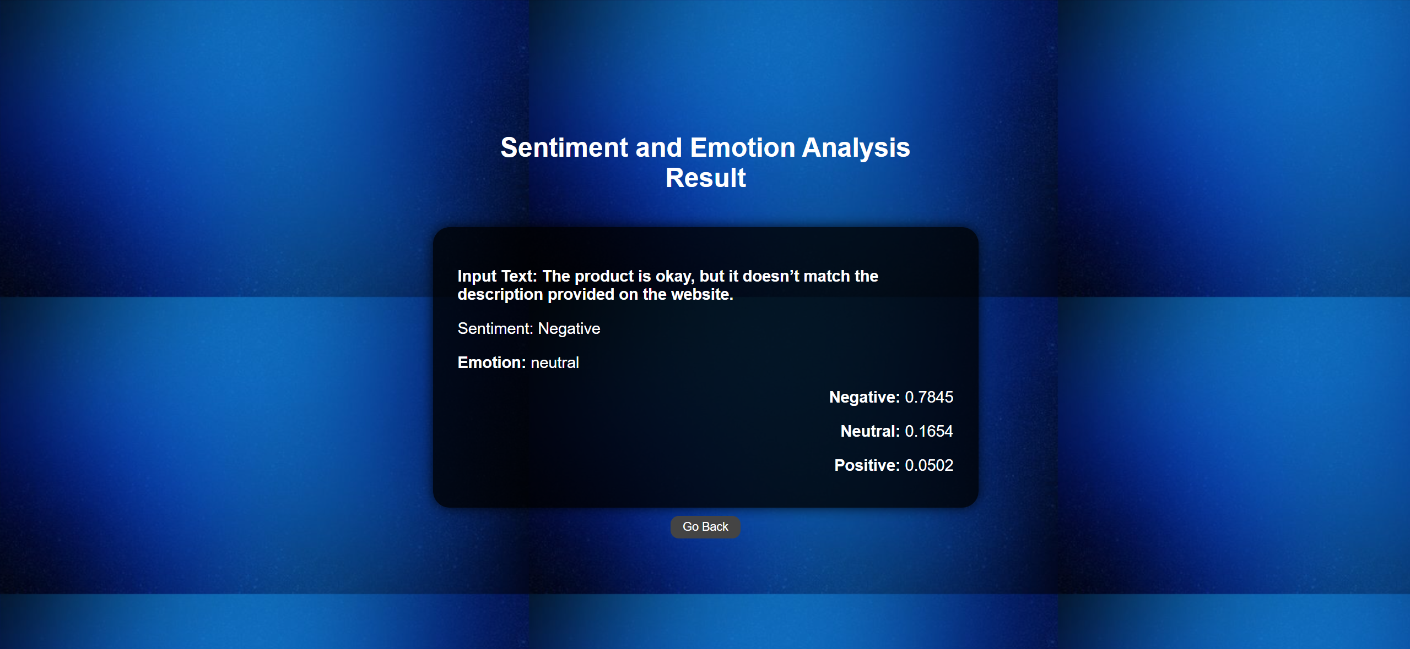

Slide 9
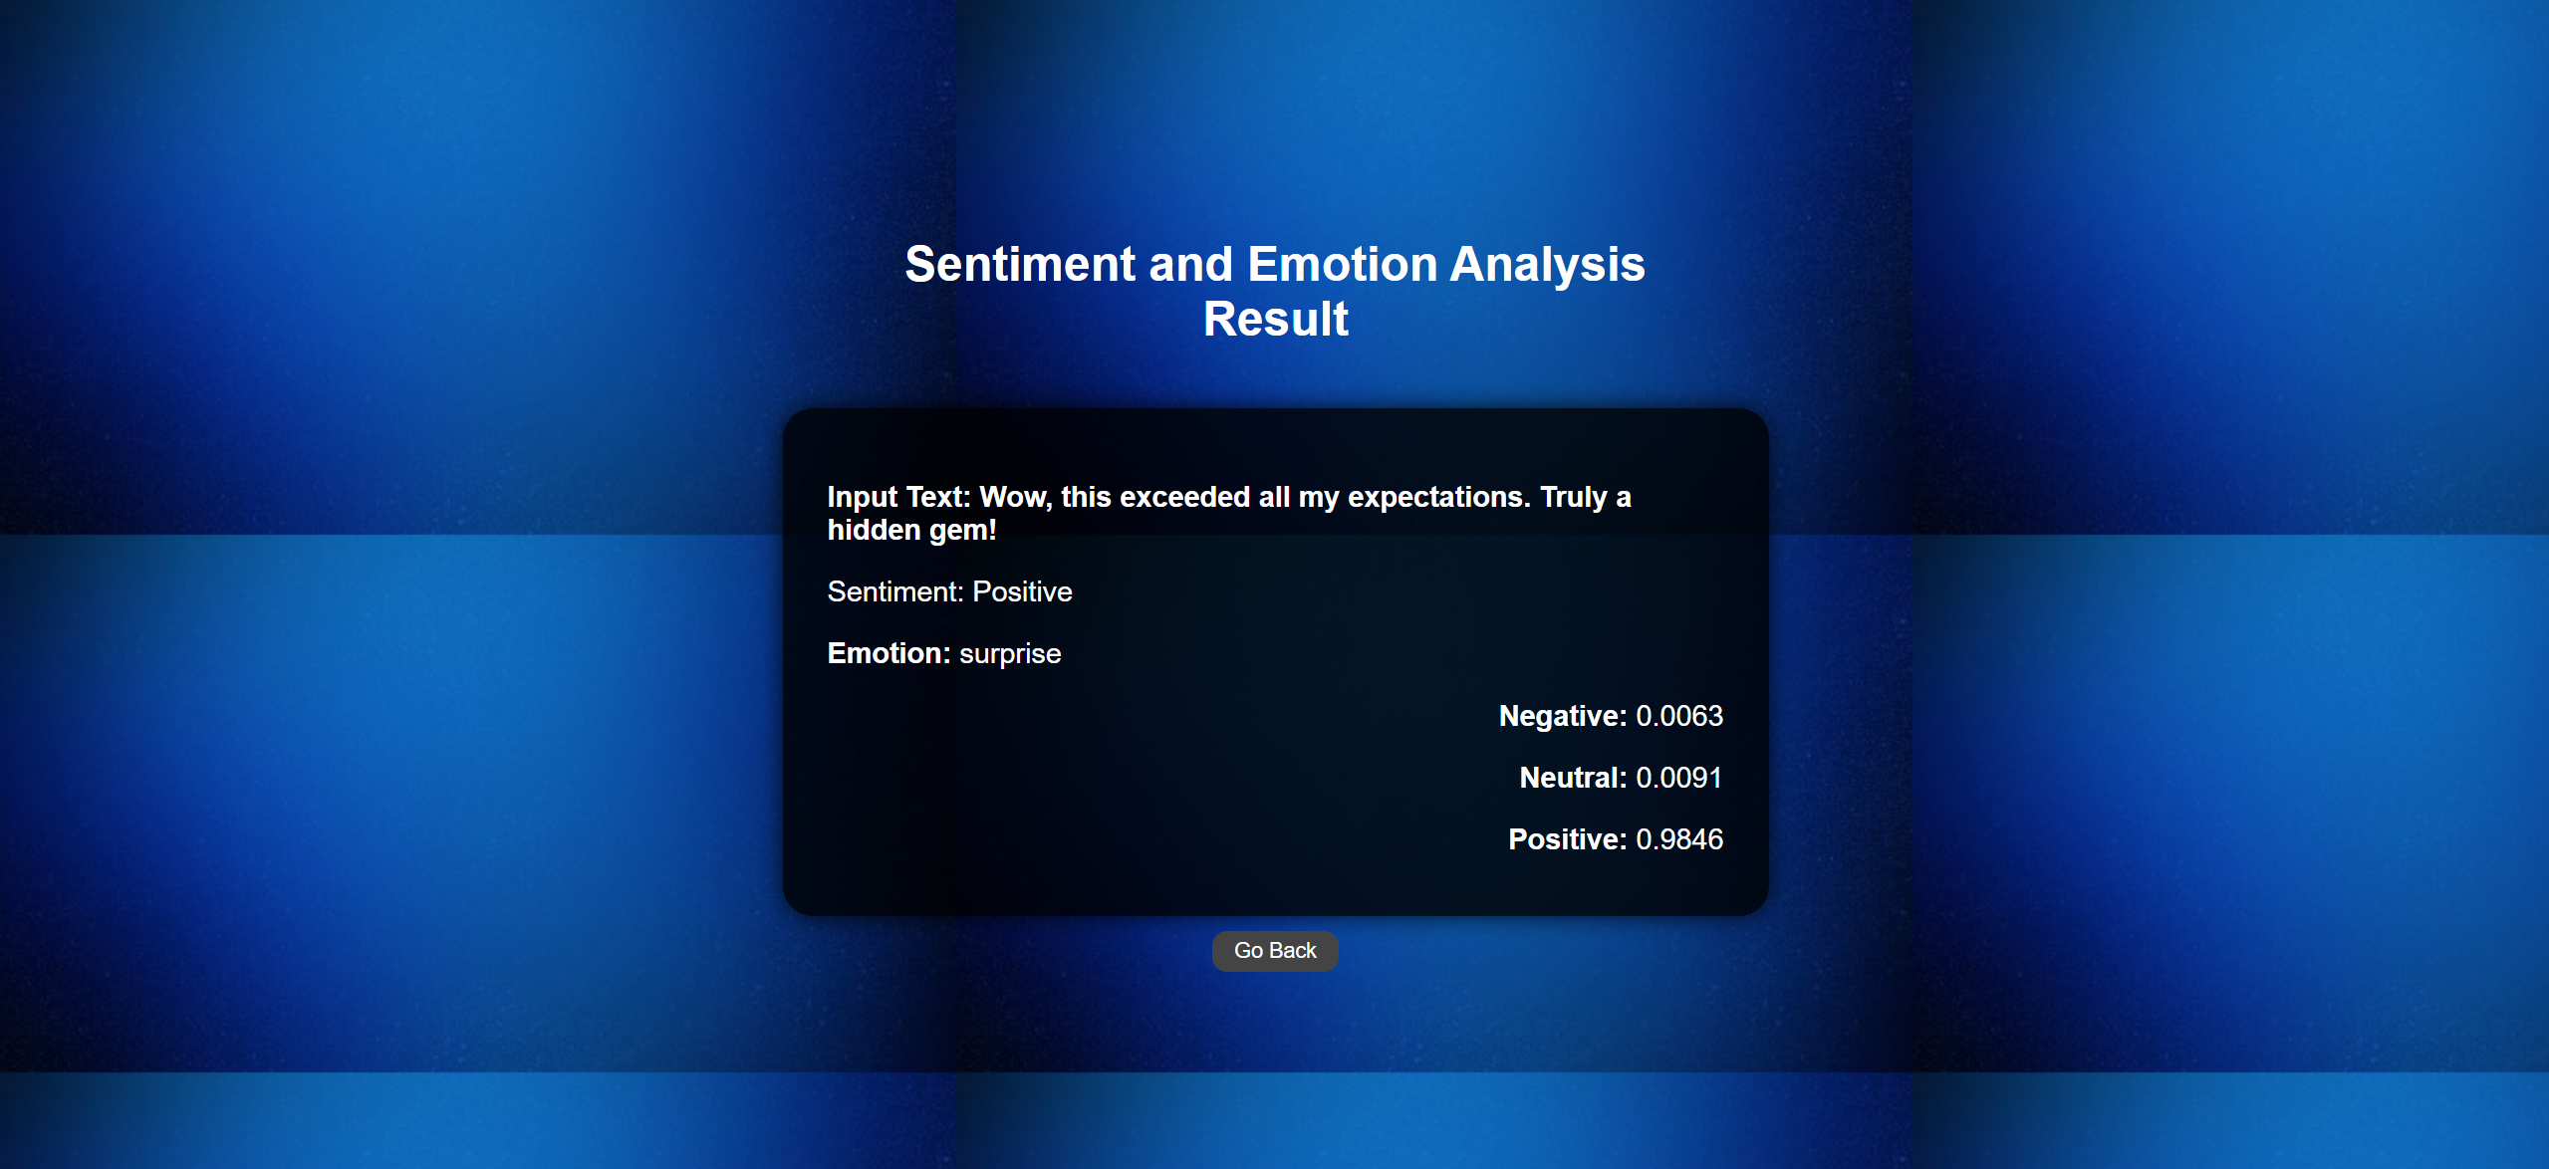

Slide 10
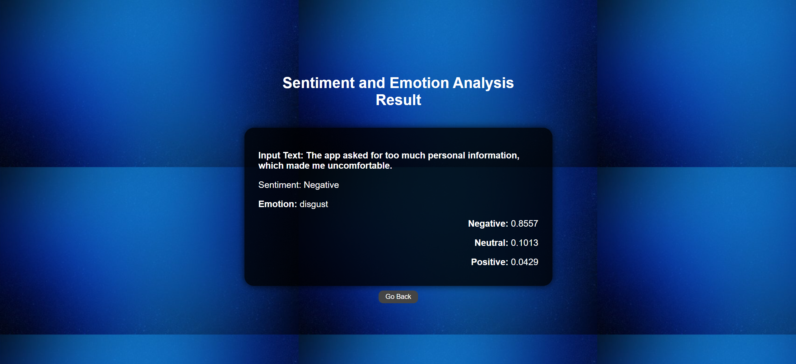

Slide 11


Slide 12
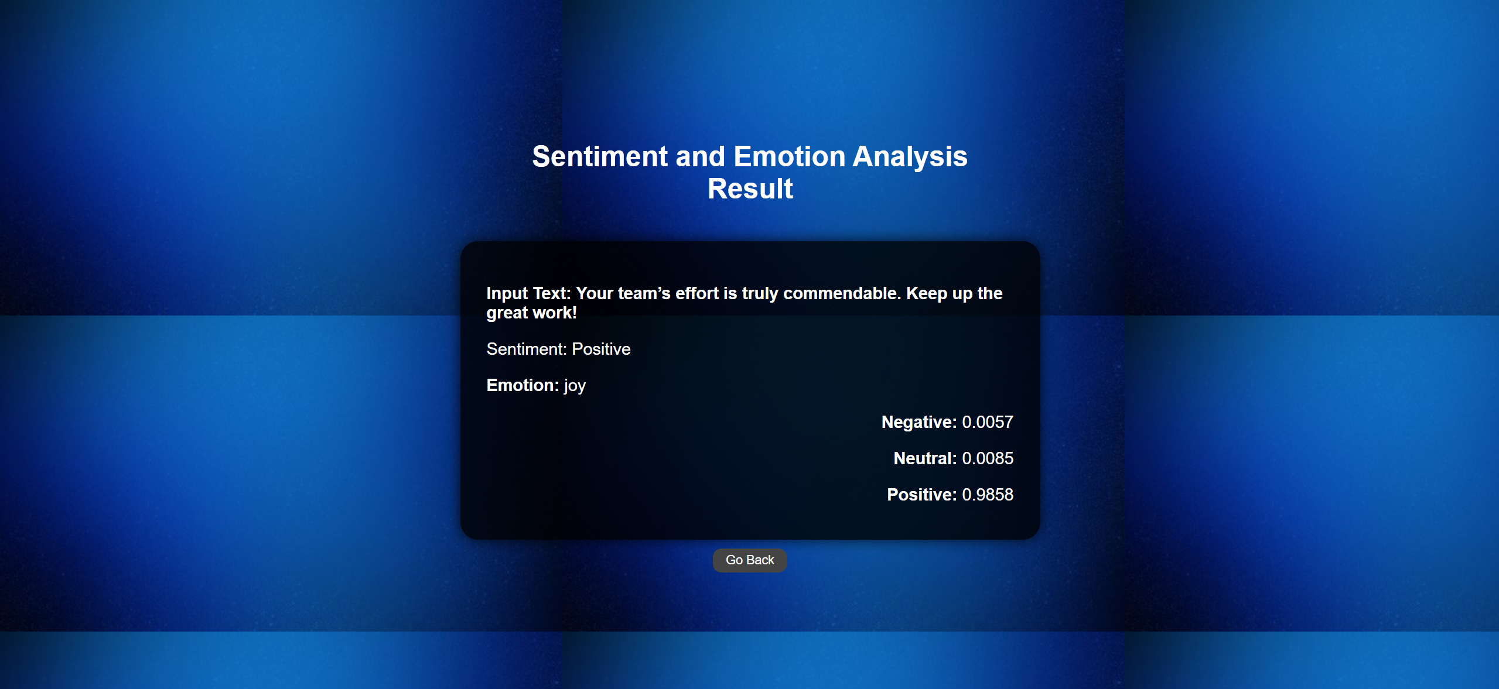

Slide 13
Thank You!
Notes:
© Copyright PresentationGO.com – Free Templates & Infographics for PowerPoint and Google Slides

